Slide 1
Decadal variability of Monsoon Core Zone rainfall, abstract ID 19
Seventh WMO International Workshop on Monsoon (IWM-7)
22-26 March, 2022, IMD, MoES, New Delhi, India
Subrota Halder^{1,2,*}, Anant Parekh¹, Jasti S. Chowdary¹ and C. Gnanaseelan¹
¹Indian Institute of Tropical Meteorology, Ministry of Earth Sciences, Pune – 411008
²Savitribai Phule Pune University, Pune – 411007
Presented by: Subrota Halder
Email of presenting author: subrotahalder.jrf@tropmet.res.in
Objective of the paper : To study the decadal variability of Monsoon Core Zone rainfall and its association with sea surface temperature variability

Slide 2
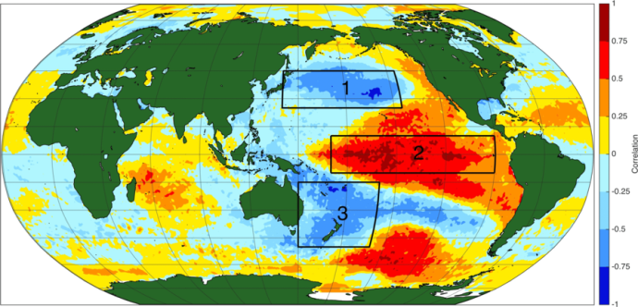
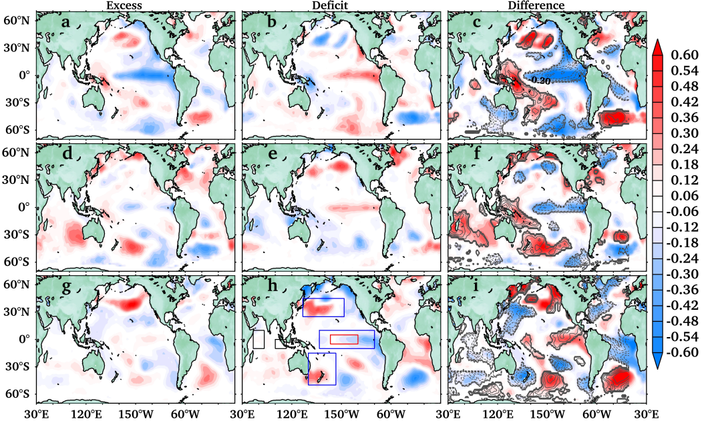
Data, Methodology, Results & Summary
Observation Data
SST: ERSSTv5 (1854–2020, 2°×2°)
(Smith and Reynolds, 2003)
Precipitation:
UDEL; 1900–2014 , 0.5°x0.5°
GPCC version 2018; 1900–2016, 0.5°x0.5°
IMD; 1900–Present, 0.25°x0.25°
(Pai et al., 2014)
31 years running correlation of filtered MCZI with different filtered SST indices. Magenta line represents the 90% confidence level for correlation.
Techniques: Spectrum, wavelet analysis, Band pass filter, Correlation and composite analysis
Henley et al., 2015
Correlation of TPI (IPO) index and filtered SSTA .
Decadal variability in rainfall over the MCZ displays time varying relationship (correlation) with the dominant SST modes.
Dynamical and thermodynamical processes to be studied thoroughly for establishing the mechanism of MCZ rainfall decadal variability.
Composite of summer mean SSTA (°C) from ERSSTv5 for a excess, b deficit rainfall years and c diference (a – b) for period 1. d, e and f for period 2, and g, h and i for period 3. Contours showing the correlation of filtered MCZI with filtered SST at 90% confidence

